Slide 1

Personal Loan Campaign Analysis
Name:
Roll No:

Slide 2
Table of Content
Overview
Objectives
Problem Statement
EDA
Models
Feature Selection
Model Evaluation
Recommendations

Slide 3
Overview: Business Understanding
Credit Nationale Azur, a French bank, has opened an office in Melbourne. Currently, 15% of their clients are making use of the personal loans offered as part of a campaign started last year. The bank now wants to start a new campaign, focusing on reaching their target market to cut costs and save time.

Slide 4
Objectives
Identify Characteristics of Loan Takers: To examine past consumer information to determine the traits of clients who have taken out personal loans.
Predict Potential Loan Takers: To create a prediction model based on these attributes to find new clients who are likely to take out personal loans.

Slide 5
Problem Statement
The bank attempts to create a prediction algorithm that reliably identifies possible loan applicants based on these attributes by examining past customer data. With this focused strategy, the bank will be able to:
- Simplify its advertising campaigns.
- Cut back on campaign expenses.
- Increase productivity.
- Reach a greater percentage of conversion.
- Boost interaction with the client.

Slide 6
EDA
Outliers:
Outliers are the datapoints which are different from the other data, shows unusual or unexpected data points that deviate significantly from the norm or expected pattern within a dataset.
Remove Outliers.
Using: 1. Z-score, 2. IQR
Z-score:
A Z-score represents how many standard deviations a data point is from the mean of the dataset.
IQR:
The Interquartile Range (IQR) is the measure of the middle 50% spread of a dataset, calculated as the difference between the 75th percentile (Q3) and the 25th percentile (Q1).

Slide 7
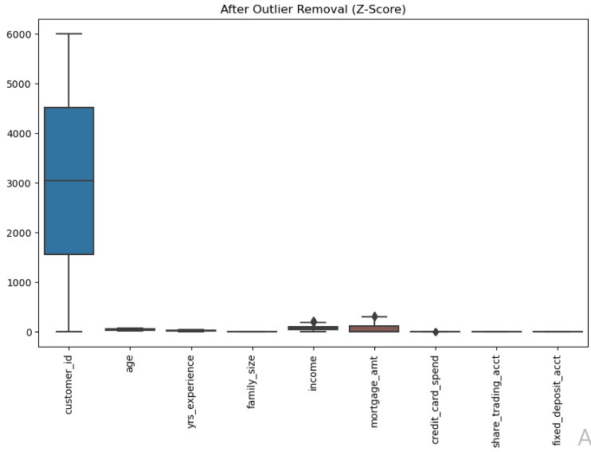
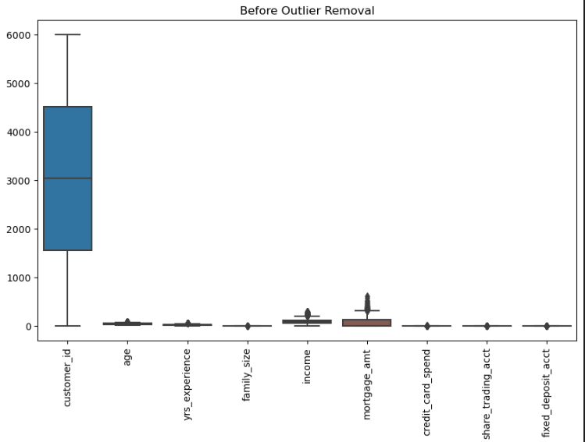
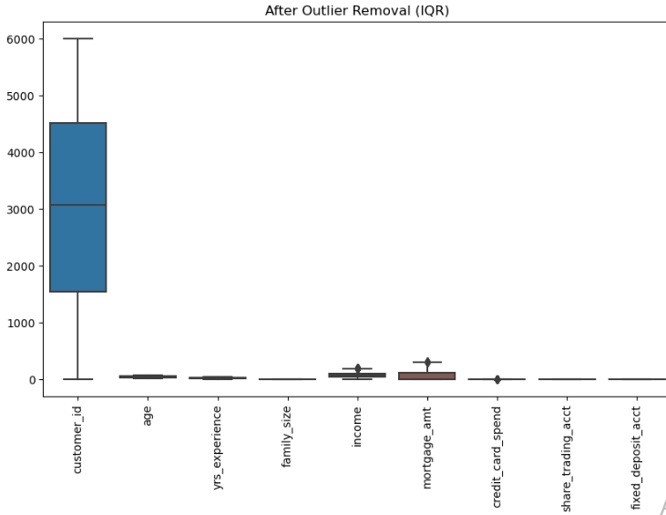
Outliers
(4685, 13)
(6000, 13)
(3944, 13)

Slide 8
EDA
Convert categorical variables (such as account types and education levels) into numerical values using methods one-hot encoding.
Handling missing Values.
Visualization

Slide 9
Models
Random Forest
An ensemble technique to increase model accuracy by combining several decision trees.
SVM(support vector machine)
A classification method that finds the hyper- plane that best separates the data into classes.

Slide 10
Feature Selection
SelectKBest
SelectKBest is a feature selection method in machine learning that selects the top k features based on a statistical test.
Usage:
Improves model performance by selecting relevant features.
Reduces computational cost and enhances interpretability.
Commonly used with tests like chi-square, ANOVA F-test.

Slide 11
Model Evaluation:
Analyze the models’ performance using metrics such as F1 score, accuracy, precision, and recall.
Overall, the Random Forest model outperforms the SVM model in predicting customers who are likely to take out a personal loan

Slide 12
Recommendations
Determine if specific client segments, such as young professionals with high incomes, are more likely to take out personal loans based on certain attributes.
Develop campaign messaging and marketing strategies that are more targeted at these specific customer segments.
Implement focused incentives and offers to clients identified as strong prospects for personal loans.
Continuously assess and improve the prediction model with new data and user feedback to enhance campaign effectiveness over time.

Slide 13

Thank You

